Slide 1

PHISHING ATTACKS

Slide 2

Introduction
Understanding phishing and its impact on individuals and organizations. Identifying common phishing tactics and the importance of cybersecurity measures.

Slide 3

What is Phishing
Deﬁning phishing as fraudulent attempts to obtain sensitive information. Examples of phishing methods such as email spooﬁng and pharming.

Slide 4
Recognizing Phishing Attempts
Identifying red fiags in emails and websites, such as urgent requests for personal information and suspicious links. Importance of verifying the sender's identity.

Slide 5
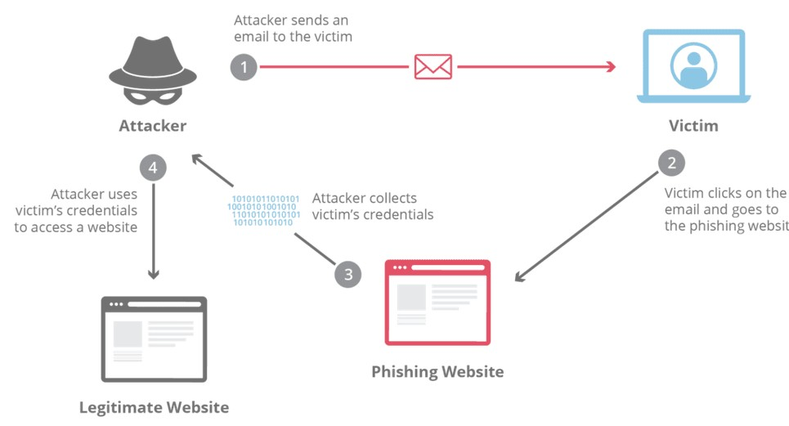
Typical Phishing Attack Scenario

Slide 6

Types of Phishing Attacks
Exploring various types of phishing, including spear phishing, vishing, and smishing.
Understanding how each method targets
individuals and organizations.

Slide 7
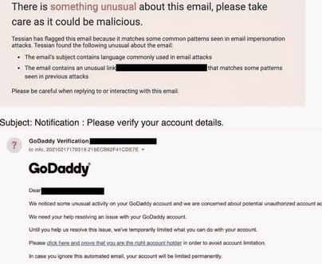
Spear Phishing
It a type of phishing attack that targets speciﬁc individuals or organizations typically through malicious emails

Slide 8
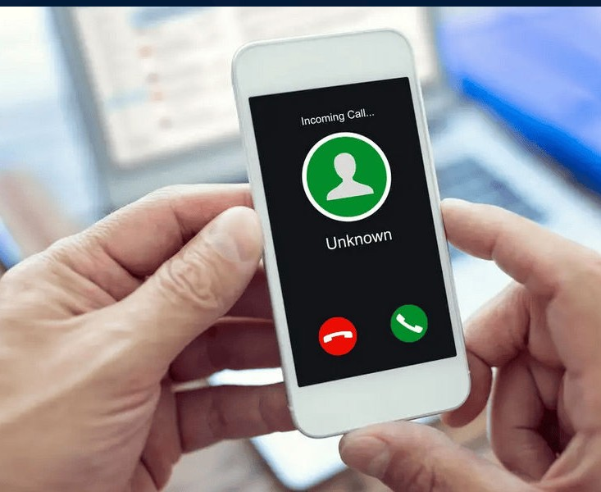
Vishing
A portmanteau of voice and phishing attacks are performed over the phone, and are considered a type of a social engineering attack, as they use psychology to trick victims into
handing over sensitive information or performing some action on the
attacker's behalf.

Slide 9
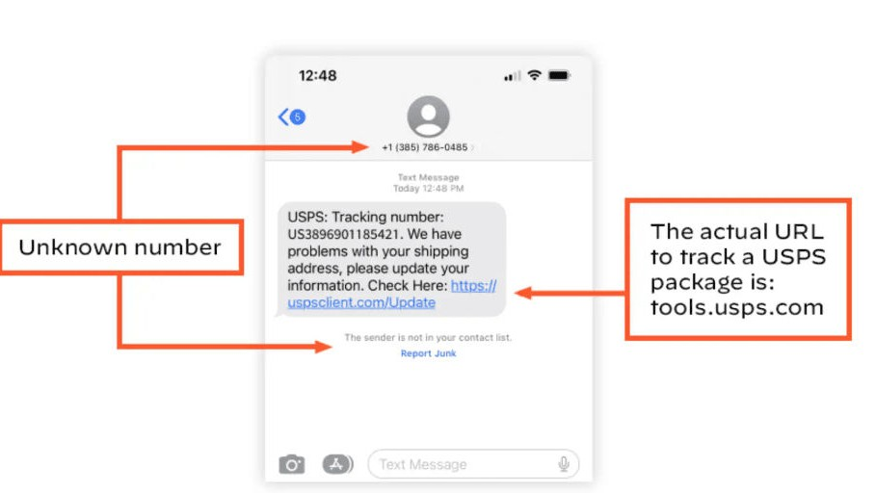
Smishing
A social engineering attack that uses fake mobile text messages to trick people into downloading malware, sharing sensitive information or sending money to cybercriminals. The term “smishing” is a combination of “SMS”— or “short message service,” the technology behind text messages— and “phishing.”

Slide 10

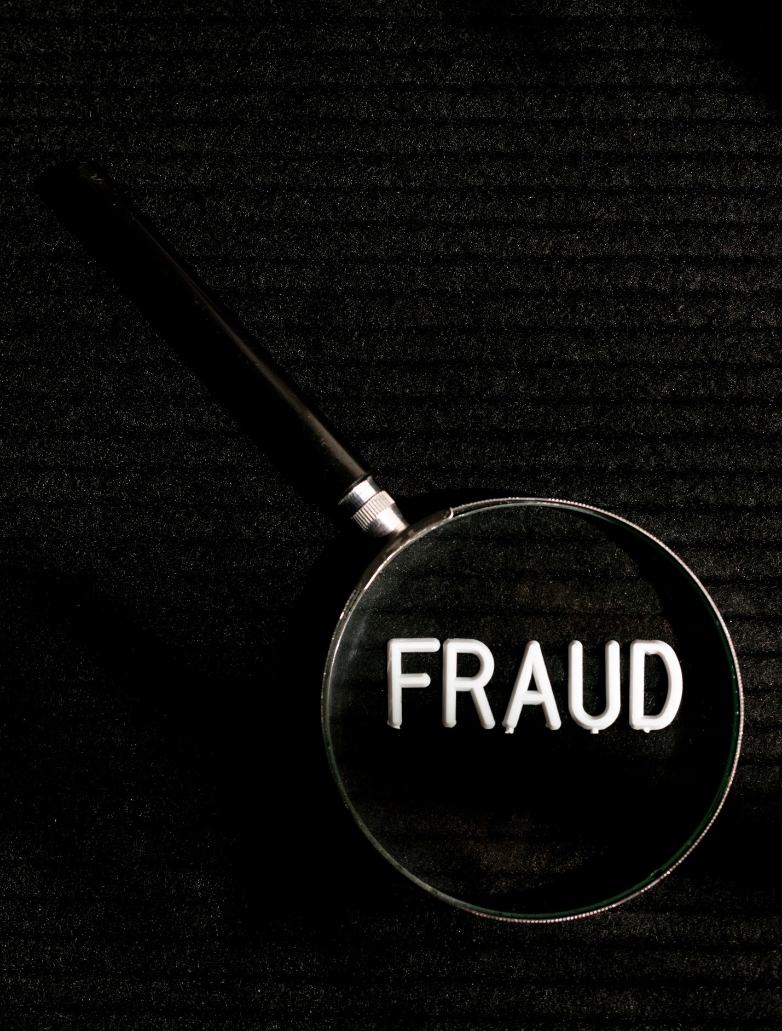
Phishing Prevention Techniques
Implementing multi- factor authentication and security awareness training. Utilizing anti- phishing tools and regularly updating security software.

Slide 11
Email Security Best Practices
Emphasizing the importance of strong passwords and encryption. Utilizing email ﬁltering and digital signatures to enhance email security.

Slide 12

Reporting Phishing Attempts
Encouraging individuals to report suspicious emails and websites to the appropriate IT department or cybersecurity authority. Highlighting the role of incident response.

Slide 13
Phishing Case Studies
Analyzing real-world examples of successful phishing attacks and their impact on individuals and organizations. Learning from notable phishing incidents.

Slide 14


Social Engineering and Phishing
Exploring the connection between social engineering and phishing. Understanding how psychological manipulation is used to execute phishing attacks.

Slide 15

Phishing and Financial Fraud
Examining the link between phishing and ﬁnancial fraud.
Discussing the ﬁnancial
implications of falling victim to phishing attacks and scams.

Slide 16

Future of Phishing Prevention
Exploring emerging technologies and strategies for combating evolving phishing tactics. Discussing the role of AI and machine learning in phishing prevention.

Slide 17
Conclusion
Recap of key strategies to guard against phishing. Emphasizing the ongoing need for vigilance and education in the ﬁght against phishing attacks.

Slide 18

Thanks!

